Slide 1
Incorporating Japanese Studies into the Curriculum
Lottis Shearer-Knowles
University of The Bahamas

Slide 2
Why is Japanese Studies Necessary?
The Bahamas has seen a growing increase in the amount of Japanese tourists visiting our shores and working as consultants in both private and public sectors.
There is no presence of Japanese culture or communities in The Bahamas. The Japanese Ambassador has his embassy in Jamaica.
While The Confucius Institute is thriving at the University, students have no opportunities to learn about Japan and it’s rich heritage.

Slide 3
What’s the Plan?
Introduce aspects of Japanese culture in an existing first year communication class.
Make the activities fun and engaging to whet the students’ appetites and create a desire for more Japanese experiences.
Use the students to promote Japanese culture to other students through a class project.
Have the upper level electives written and approved in the upcoming academic year.

Slide 4
What is the Course?
Introduction to
Human Communication

Slide 5
Introduction to Human Communication
In this course, students focus on the development, functions and dynamics of human communication and apply these to their own experiences. They examine the influences of culture and language on human communication and the impact of interpersonal and group interactions on the communication process.

Slide 6
Who Takes This Course?
First year students who are either entering the university for the first time or beginning their second semester.

Slide 7
Why This Group?
The best people to market a programme to students are students.
The earlier they are interested in Japanese studies, the easier it will be fill the upper level electives that will be written.

Slide 8
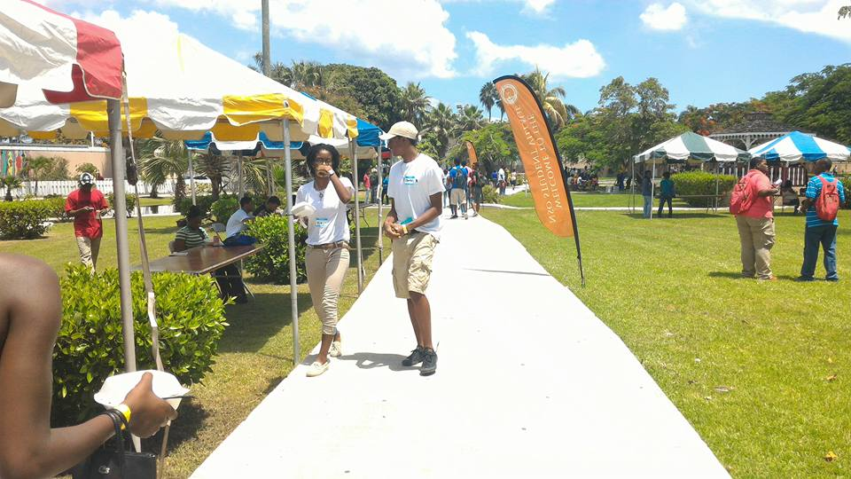
How Will Japanese Culture Be Added?
Three modules that focus on verbal and non verbal communication in Japanese culture.
Nine contact hours
Approximately 100 students, four sections.

Slide 9
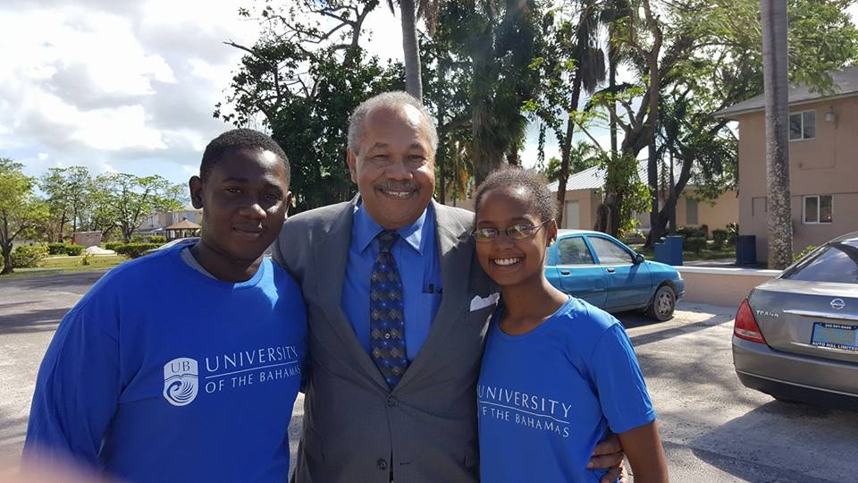
What Will The Modules Look Like?
Week One:
A brief history of Japan and its people
Verbal Communication
Students will familiarize themselves with sound of the language and learn basic Japanese greetings that will be used throughout the experience.

Slide 10
Week Two
Nonverbal Communication
Students will learn how to interact with Japanese nationals using appropriate nonverbal behaviour
They will learn about values that are important to Japanese culture
Movie – Students will watch a Japanese movie that demonstrates aspects of nonverbal behaviour discussed in class, then we will talk about the movie.

Slide 11
Week Three
The significance of nature in Japanese Culture
Introduction of Haiku
Students will create a Haiku using Bahamian aspects of nature
This will be probably be done in teams or small groups as a competition.

Slide 12
Student Project

Slide 13
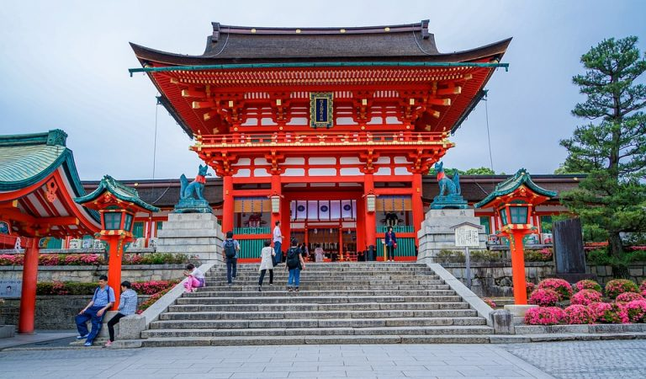
A Taste of Japan

Slide 14
The entire class will plan a two hour event to introduce the university community to aspects of Japanese Culture.
The entire class will be responsible for securing the open space, promoting the event and setting up the space creating the right ambience through decorations and music.
Students will be placed in groups of five members.
Each group will be asked to select a Province of Japan.
They will select cultural aspects of the Province to share with other students. These may include foods, information about the Province, special rituals, language etc. The groups will think of creative ways to stimulate students interest in their displays.
Finally, each group will turn in a written report about their Province, highlighting what they learned from their research.

Slide 15
Where And When Will This Take Place?
In the fall semesters, it will take place in the Student Union Building around mid semester during the Thursday 2:00-4:00 break.
In the spring semesters, it will take place during International Cultures Week (an annual event hosted by the Foreign Languages Department).

Slide 16
Upper Level Courses to be Written
Intercultural Communication
Japanese Cinema
The End

