Slide 1
AASCU/ JSI Curriculum Development Project
Cohort 2018
“Japan and School Psychology: How to stimulate interest in Japan among students in my field?”
Darla M. Scott, Ph.D.
ダーラ スコット
Bowie State University

Slide 2
Objectives
To communicate my personal motivations in participating in JSI and distill my lessons learned from this experience
To stimulate interest in Japan among Bowie State (BSU) students through enhanced curriculum and experiences
To share my plan for implementing my curriculum development project at BSU during the 2017-18 academic year

Slide 3
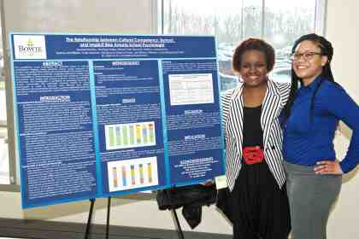
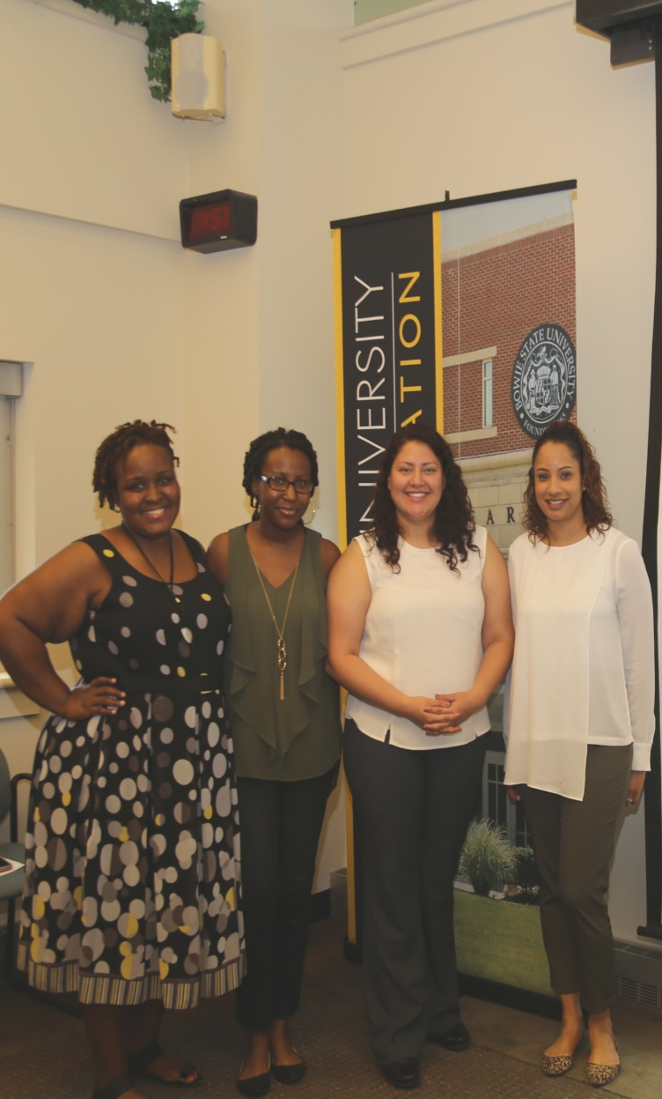
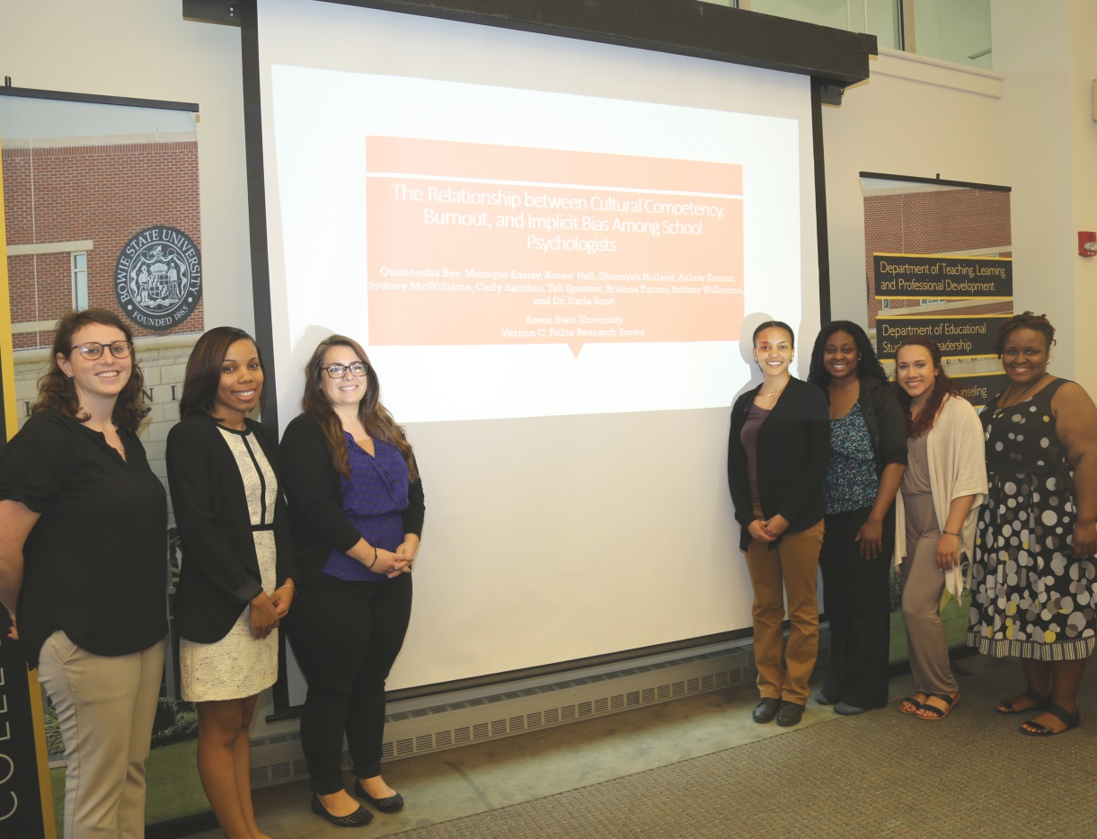

Slide 4
What brought me here?
Cultural scientist
2018 International School Psychology Association conference in July
13 graduate students in school psychology
CLD parental protective factors, risks, and achievement
Racial Bias, Burnout, and Cultural Competence training among in-service school psychologists
Looking for new ideas, solutions, and methodologies (2018 American Evaluation Association Fellow)

Slide 5
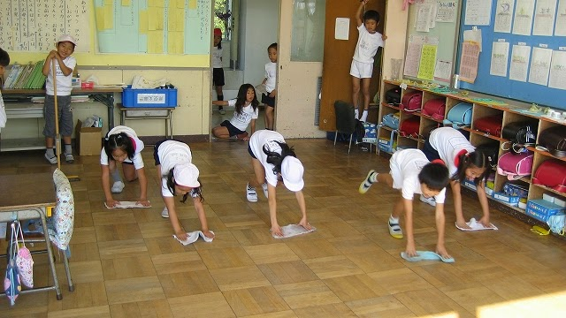
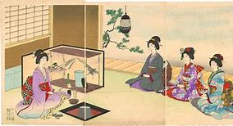
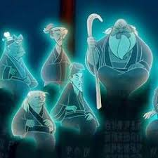
第
Notes:
Kanji is ART in Japanese

Slide 6
What I learned?
Collaborative intellectual exchanges across sectors (supporting innovation)
Resources from Japanese government for cultural exchange and studies (JET, Japan Foundation, etc.)
Cultural intermediation in art, education, popular culture (the value of the “go between”)
Advocacy in special education as a cultural construct and key structural differences

Slide 7
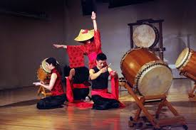
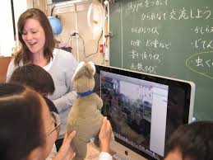
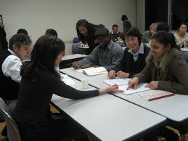

Slide 8
What I am planning to do?
With my students
Group Dynamics Module
Psychology of Exceptional Children
With my colleagues
Departmental Brown Bag
Faculty Institute workshop
With my university
Diversity and Inclusion committee events and outreach
Resources for University administrators

Slide 9
With my students: Curriculum Development activities
Prepare my current student researchers for Japan
Group Dynamics Module on International Business (Chapters 13-14 Diversity & Transnational Teams)
Include readings from IntXel Cross-Cultural presentation
Construct an assignment around the Kyocera Amoeba Management System and how it impacts transnational collaborations
Utilize case studies with graduate students
Psychology of Exceptional Children course
Include articles on the current utilization of special educational services in Japan with an advocacy development assignment

Slide 10
With my Colleagues: Faculty Development activities
Conduct a Counseling Department brown bag to share my “take aways” from the JSI
Including Only the Brave video clip, GateBox ad, and hands-on demonstrations with time to discuss course level implications
Develop workshop for spring 2018 institute with following goals:
To provide a brief introduction to the educational system in Japan and related implications for future Japanese Studies programming and potential activities for current students

Slide 11
With my University: Diversity and Inclusion activities
Organize Japan focused cultural enrichment activity within forums for understanding other cultures
Speakers like Akiko Mikamo and movies like Only the Brave (coincide with global recognition events)
Share available funding resources with Bowie State University Academic Affairs office (and IA) from Japan Foundation and other entities supporting Japanese Studies programming on the institutional level

Slide 12
In Summary: JSI Curriculum Development Products
Group Dynamics Two Week Module with Japan infused content
Psychology of Exceptional Children Special Education Japanese Comparative Assignment
Three Agendas: Departmental Brown Bag, Faculty Institute Japanese Studies Workshop, and Diversity & Inclusion Japanese Enrichment event
One-pager summarizing most promising funding resources for Japanese Studies programming, research and student exchange to submit to BSU administration

Slide 13
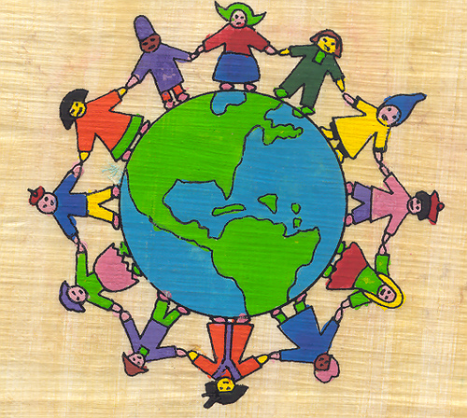
Questions & Comments
Are there any topics that you would add to what I plan to share?
Which activities would you share first with your colleagues?
Thank you all so much for this opportunity and your patience with me during a difficult time!

